Slide 1

Redesign for Bad Graphs
Project Group 8
STAT-515-005
(Spring 2023)
ROHITH PANJALA
ADITHI KALLEM

Slide 2
Introduction to Bad Graphs:
Statistical graphs are considered to be a powerful tool to express a large amount of information in a precise manner. But in some cases, it might deceive the audience.
Bad graphs are those that manipulate the provided statistical data to show false conclusions. Thus, bad graphs can be misleading as the users only look at the graphs not the data.
Using the data and presenting it as graphs will ensure that the data is treated fairly.

Slide 3
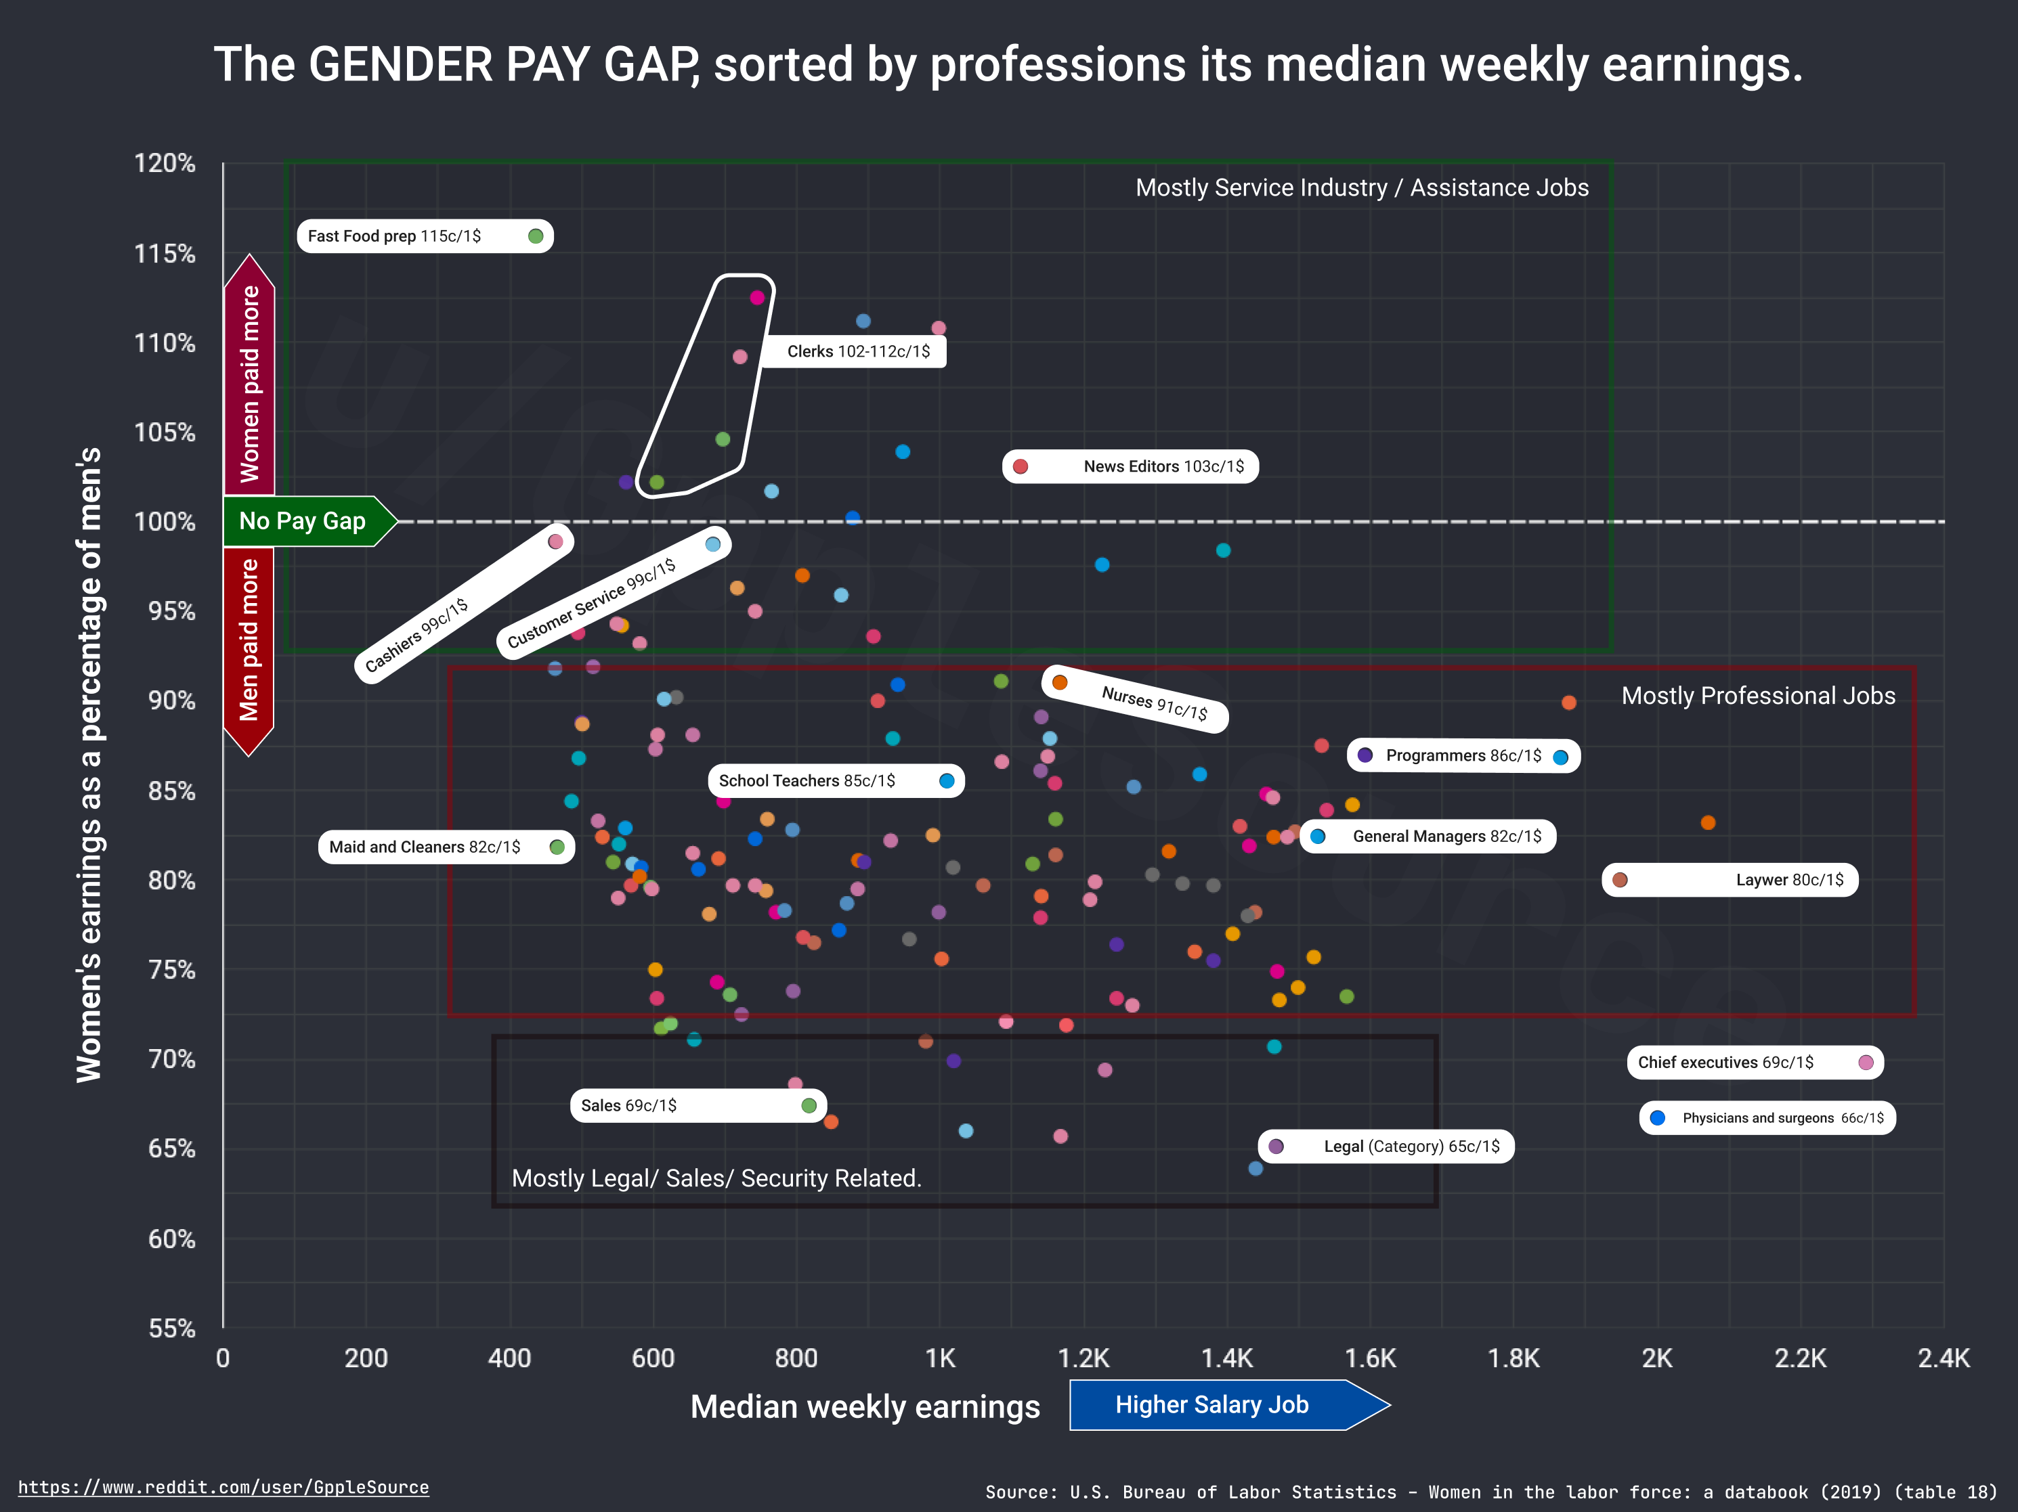
Bad graph 1: The Gender wage gap sorted by profession
Bias between men and women is evident in many fields, and it should be regarded as the most delicate subject. Therefore, it is crucial that the proper data is gathered.
The graph shows the women’s earning as a percentage of men for a specific profession based on the median weekly earnings.
We are aware that salaries for men and women generally differ across all professions. Due to the fact that it displays women's earnings as a percentage of men's earnings, this image only partially indicates how much each gender is paid.
It is difficult for the person to make a decision because the visualization is not presented in the proper way in this instance.

Slide 4
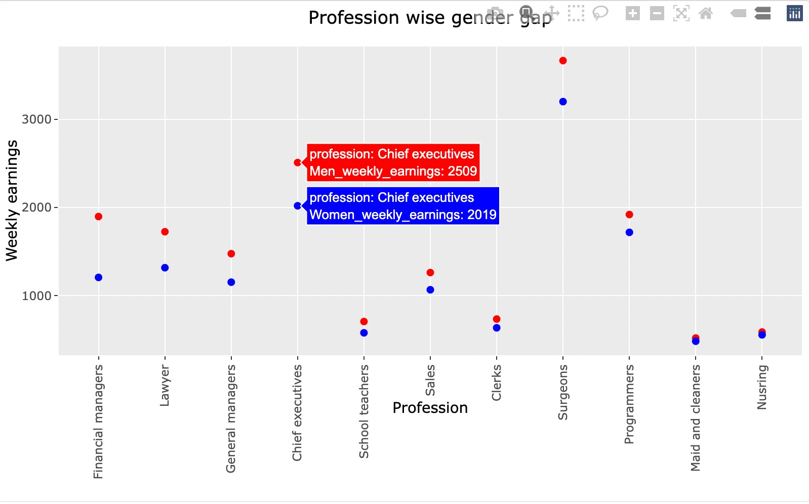
Re-designed graph 1:
By looking at the scatter plot, you can see how the complexity of the visualization has changed compared to bad graph.
The scatter plot shows the wages of male in red and female in blue respect to the profession. The professions are sorted in ascending order with respect to women’s earning as a percentage of men.
For example, there is a less wage gap for nursing when compared with other professions.

Slide 5
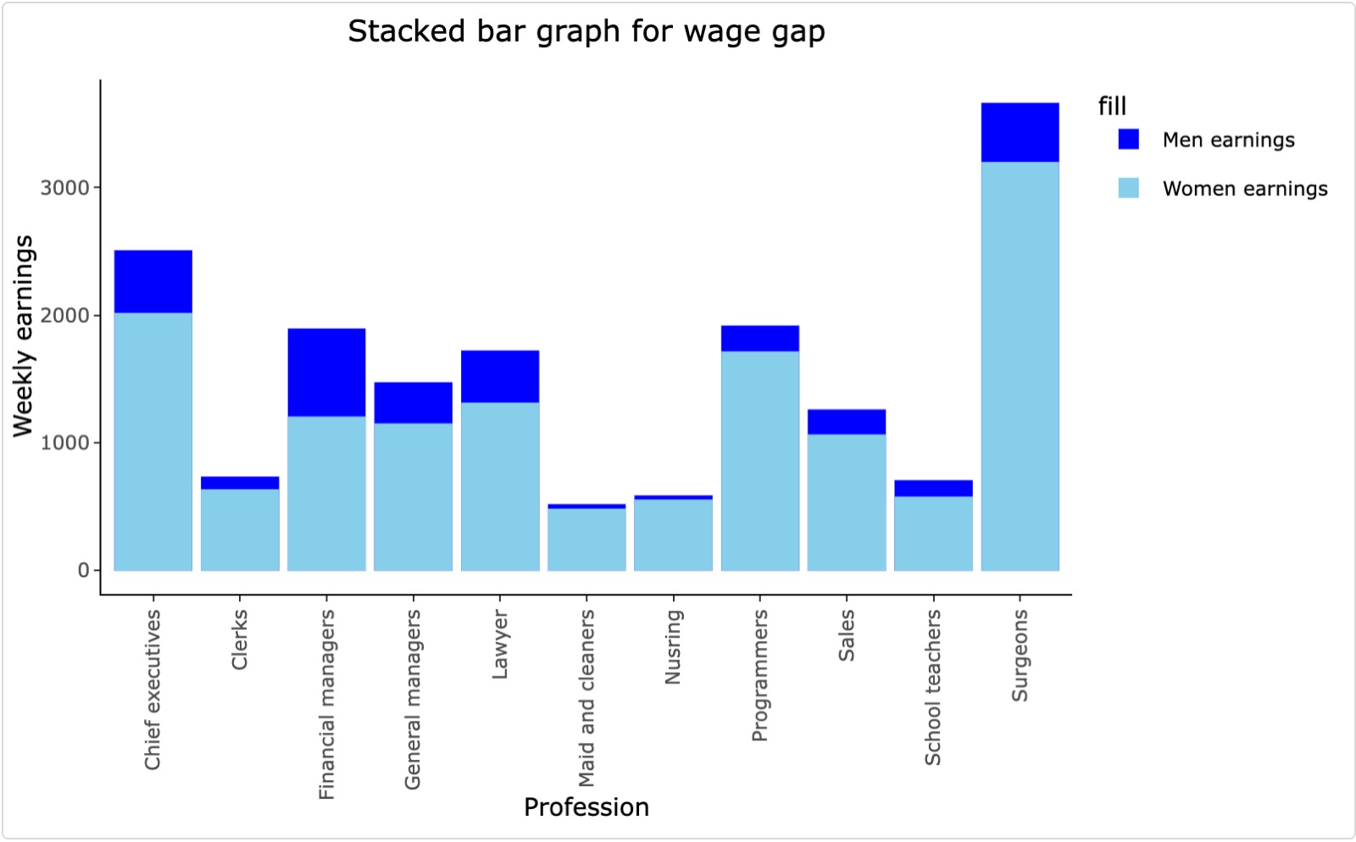
Re-designed graph 2:
The bar graph represents the men and women earning for each profession.
Men and women are depicted differently using appropriate coloring. A color legend is also displayed.
We created an interactive graph using ggplotly() so that you could see the finer details when you hovered over the bars.

Slide 6
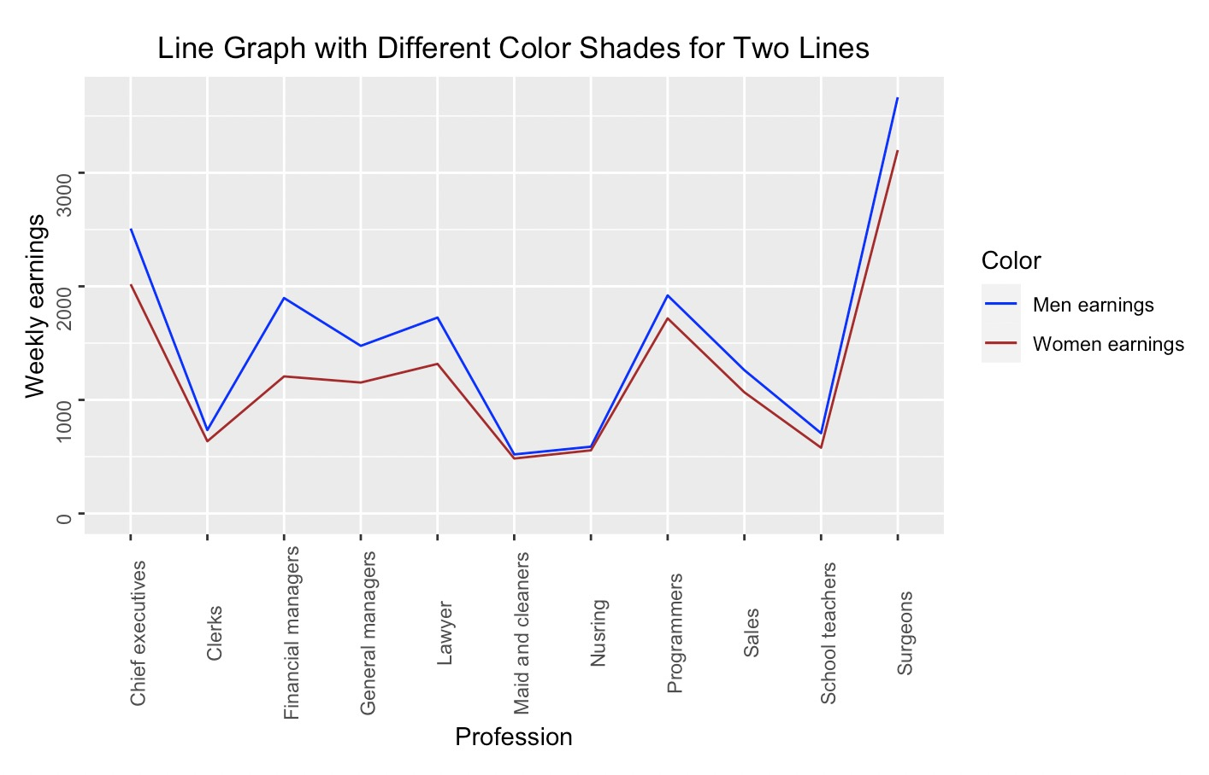
Re-designed graph 3:
In this graph we can see that the instances where the lines are converging the respective profession have less wage gap and the instance where the lines are diverging the wage gap is high.
The line graph represents the men and women earning for each profession. Men and women are depicted differently using appropriate coloring. A color legend is also displayed.

Slide 7
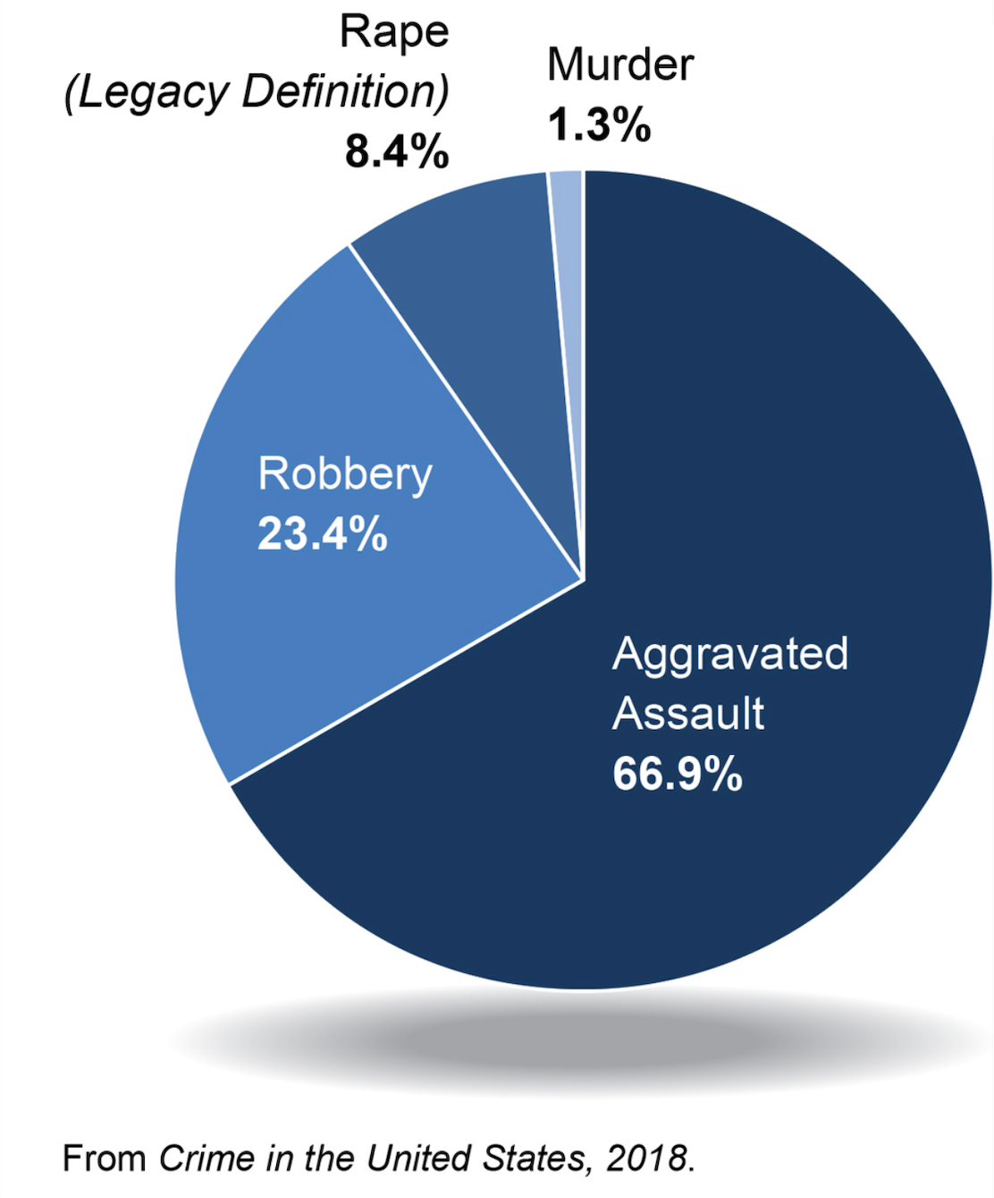
Bad graph 2: State wise US crime rate in 2018
The visualization shown above is the representation of State wise US crime rate in 2018.The graph shows the proportion of the different crimes and their rates.
In most cases, we don't use pie charts for visualizations
This information from the pie chart can be displayed in an interesting manner and can yield interesting insights.

Slide 8
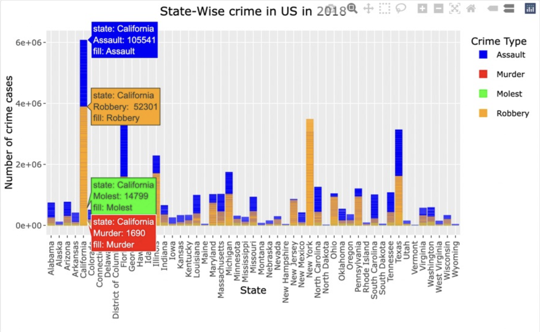
Re-designed graph:
The visualization above represents the crime type across all the US states and the number of crime cases.
The bar graph is made interactive using ggplotly() so that you could see the finer details when you hovered over the bars.
The graph clearly show that the number of cases for Assault and Robbery are comparatively high for each state.

Slide 9
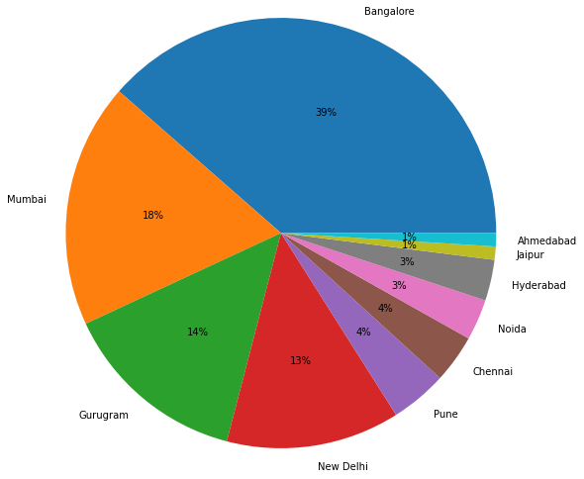
Bad graph 3:Indian startup company’s statistics 2021
The visualization shows the proportion of startup companies that have received investment across various Indian cities. In the graph number of startups in each city is shown as a percentage.
As we don’t use pie charts for most of the visualizations, we can use the data from the pie chart and represent the data in better way.

Slide 10
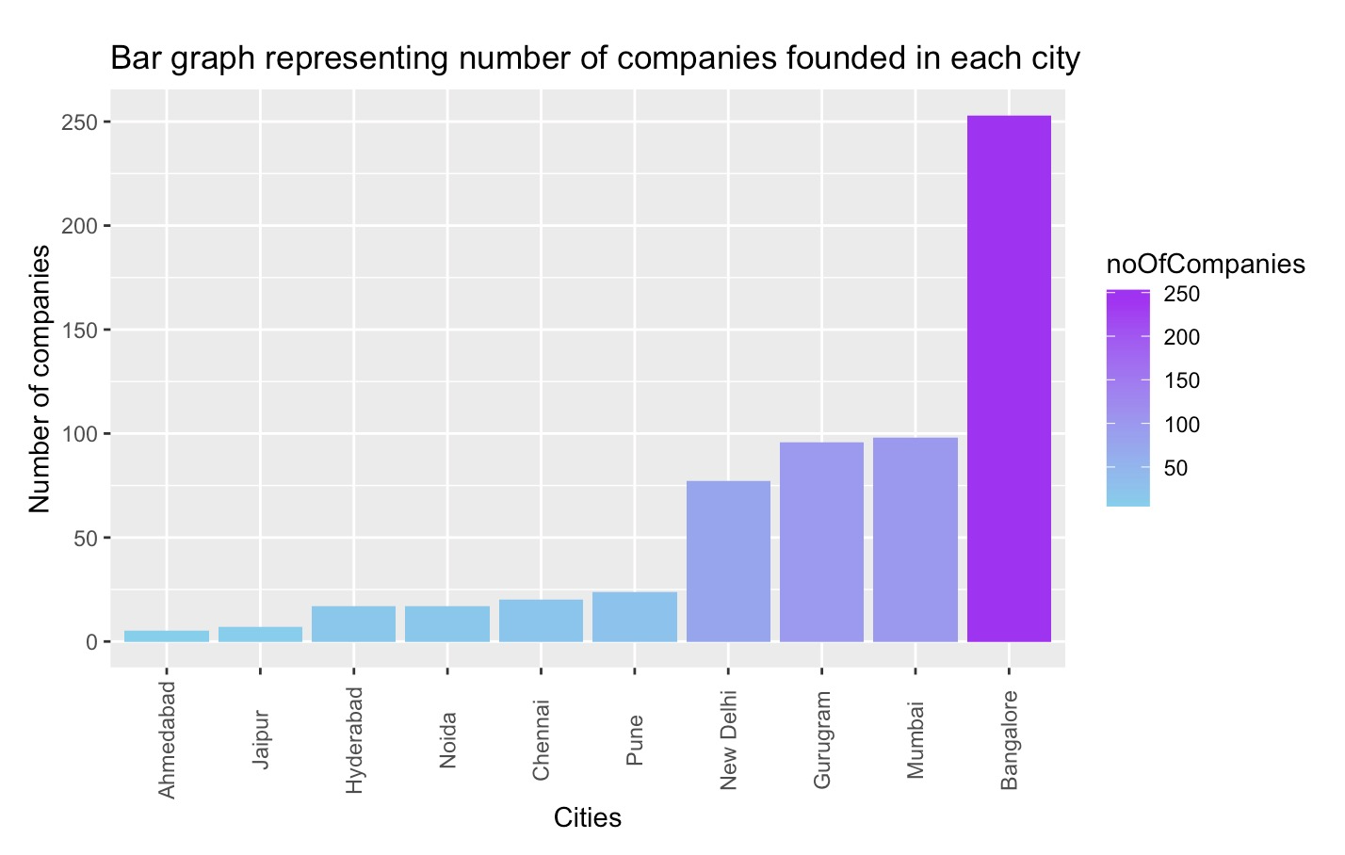
Re-designed graph 2:
In order to display the number of startups formed in Indian cities, the graph has been modified to a bar graph.
In bar chart , simply we can count the number of startup businesses that were established in each city. In addition, we added a color gradient that reflects how many companies are in each city.

Slide 11
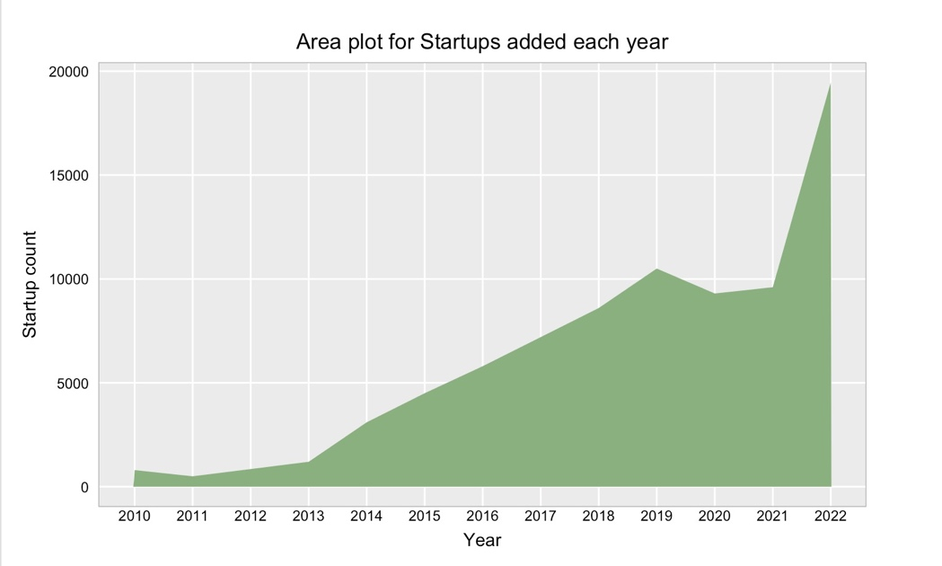
Re-designed graph 3:
The visualization is a representation of number of startup companies established in India for that particular year.
From 2010 to 2013, startup growth was passive and steady; starting in 2013, growth was linear through 2019. As the pandemic spread over the country and the world, there has been a decline in the effort to launch new firms. Subsequently, between 2021 and 2022, the growth of new startup creation has doubled.

Slide 12
Conclusion
It's important to use the right charts for the right data because bad graphs will have bad impacts.
We made good visualization for 3 bad graphs by reconstructing different graphs from the original data set
Visualization is beneficial only when the chosen data type fits the data being shown.

Slide 13
Reference
Bad Graph 1: https://www.reddit.com/r/dataisbeautiful/comments/p0z3z2/oc_the_us_gender_pay_gap_visualised_by/
Bad Graph 2: https://www.fbi.gov/news/stories/2018-crime-statistics-released-093019
Bad Graph 3:https://startuptalky.com/indian-startup-funding-investors-data-2021/

